Slide 1
WEEK 1 TASK NETWORK FUNDAMENTALS

Slide 2
TASK 1 : OSI MODEL
OSI MODEL (OPEN SYSTEMS INTERCONNECTION) has 7 layers is a conceptual framework developed by the International Organization for Standardization (ISO) to explain how communication takes place between different devices over a network.
The OSI model divides the network into 7 different layers. They are :

Slide 3
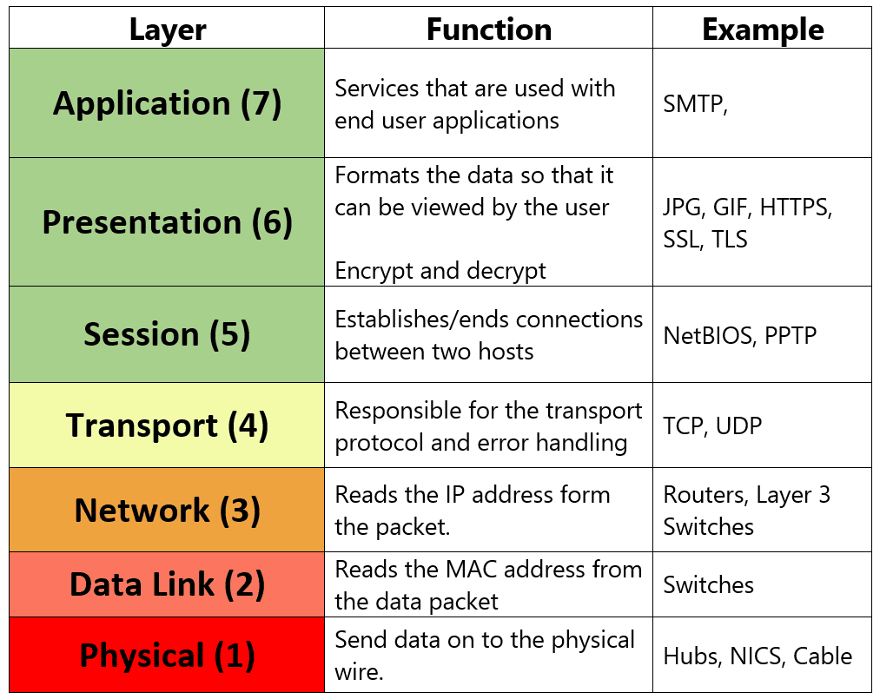

Slide 4
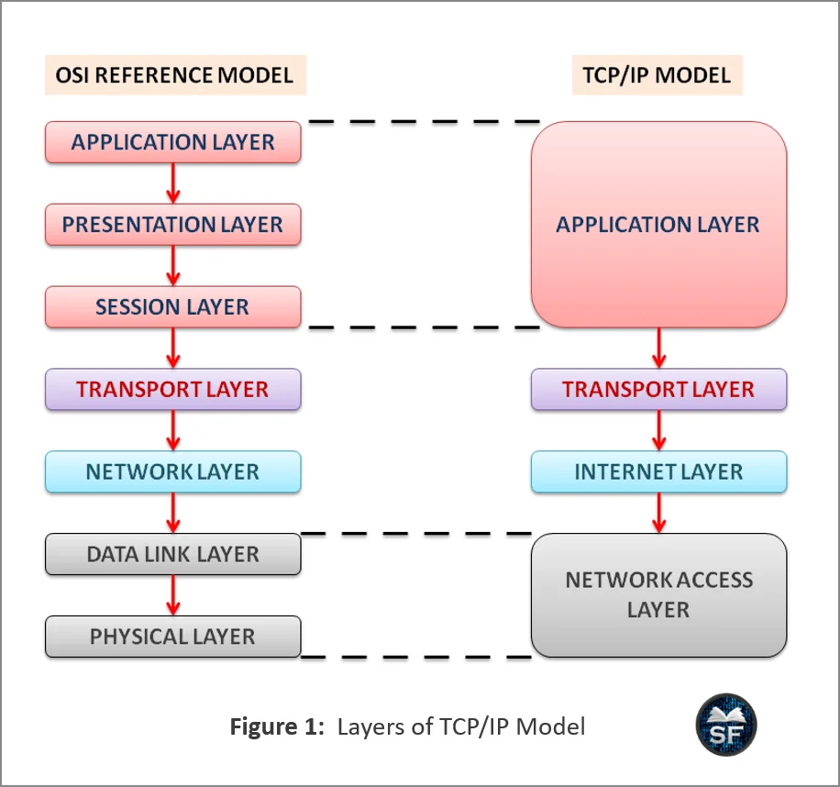
TASK 2 : TCP/IP
The TCP/IP (Transmission Control Protocol/Internet Protocol) Model is a networking framework used to describe how devices communicate over the Internet and other computer networks.
the TCP/IP model commonly has 4 layers. They are

Slide 5
Difference between OSI model and TCP/IP model
OSI MODEL | TCP/IP MODEL
Open Systems Interconnection | Transmission Control Protocol/Internet Protocol
The number of layers are 7 | The number of layers are 4
It is developed by ISO | It is developed by DARPA/DoD research community
It is mainly used for learning, design and troubleshooting It has separate layers The Model is protocol-independent | It is widely used in real-world Internet networking. It has 4 layers, with some functions combined. It is built around protocols such as TCP, IP, UDP and HTTP.

Slide 6
TASK 3 : NETWORK PROTOCOLS
A network protocol is a set of rules that defines how devices communicate and exchange data over a network.
HTTP / HTTPS : Governs communication between web browsers and web servers
Ex : When you visit a website such as a news website, your browser requests web pages, images, and other resources from the server.
FTP : File Transfer Protocol is a protocol designed for transferring files between computers over a network.
Ex : Suppose a web developer needs to upload website files to a hosting server. FTP can be used to transfer those files.
DNS : Domain Name System is a system that translates human-readable domain names into IP addresses.
Ex : when a website name is typed the device needs to determine the IP address associated with that domain.
DHCP : Dynamic Host Configuration Protocol automatically provides network configuration information to devices joining a network.
Ex : When you connect your smartphone or laptop to your home Wi-Fi, you normally don't manually enter an IP address.

Slide 7
TASK 4 : IP ADDRESSING
IP Addressing is a logical address assigned to a device connected to a network. It is used to identify the device and help deliver data to the correct destination.
Types of IP Address
IPv4 : IPv4 is the most commonly encountered IP addressing format. An IPv4 address consists of 32 bits, divided into four groups called octets.
IPV6 : IPv6 was developed to provide a much larger number of addresses than IPv4. An IPv6 address consists of 128 bits.

Slide 8
Public vs Private IP Address: A public IP address is an IP address that is used to identify a network or device on the public Internet.
A private IP address is used inside a private network, such as a home, school, office, or organization.
Ex : ISP-assigned address for public IP address and 192.168.1.10 is for private address
Basic subnetting concept: Subnetting is the process of dividing a larger IP network into smaller logical networks called subnets.
A subnet mask is used with an IPv4 address to determine which portion represents the network and which portion represents the host.
Ex : normal network : 192.168.1.0/24 Subnet mask : 255.255.255.0

Slide 9
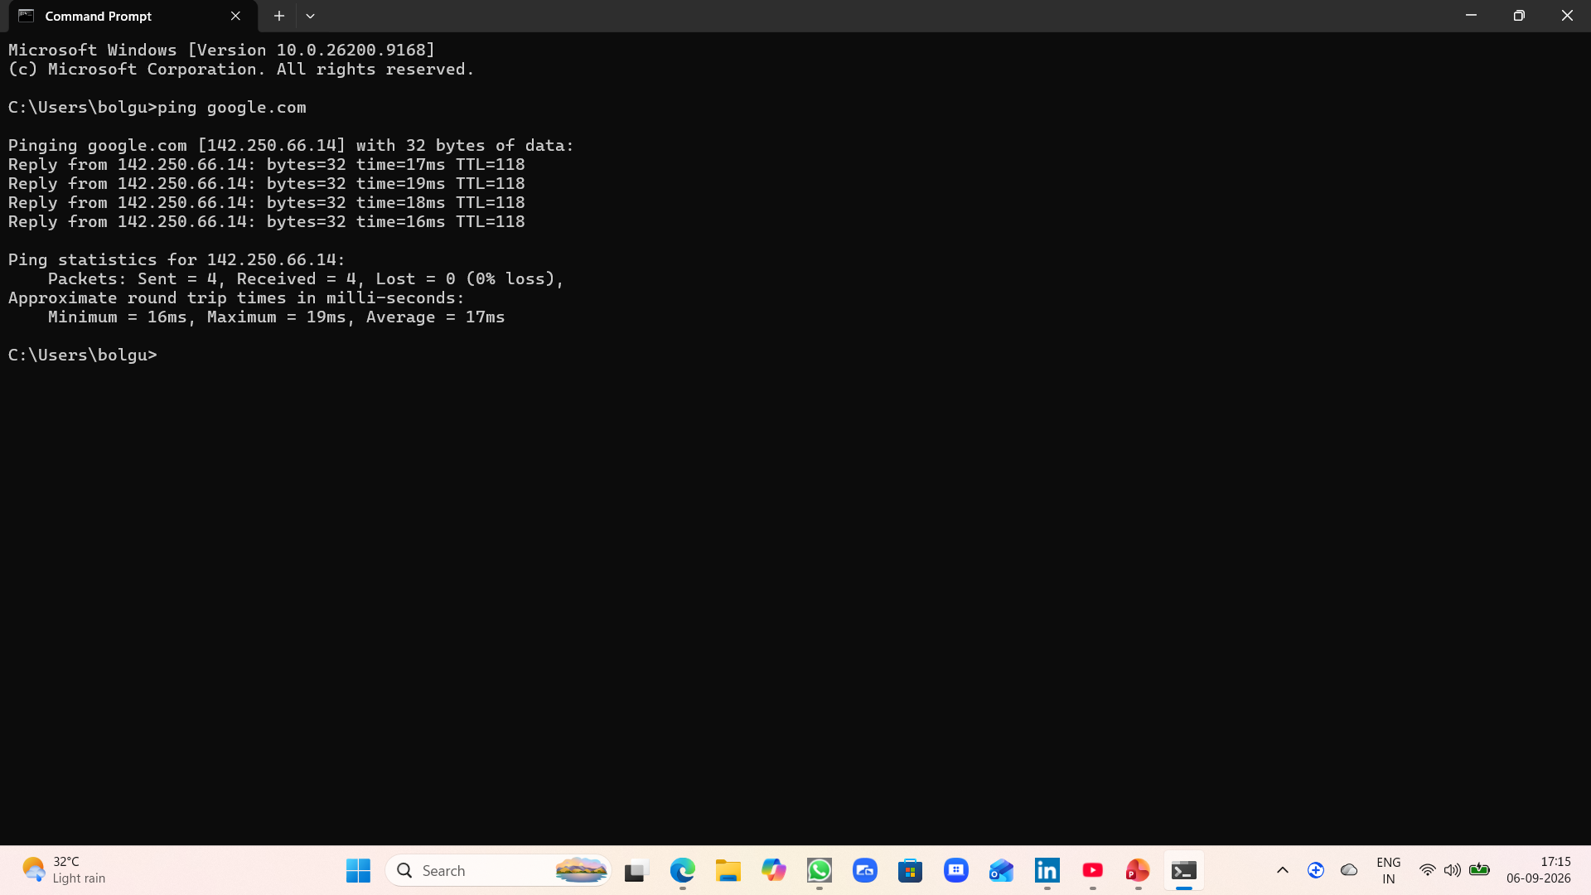
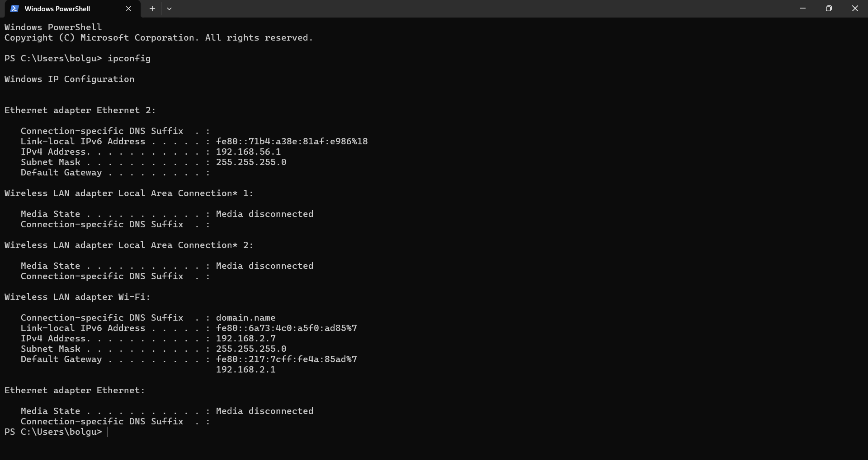
TASK 5 : NETWORK COMMANDS
Ping google.com
IP Configuration

Slide 10
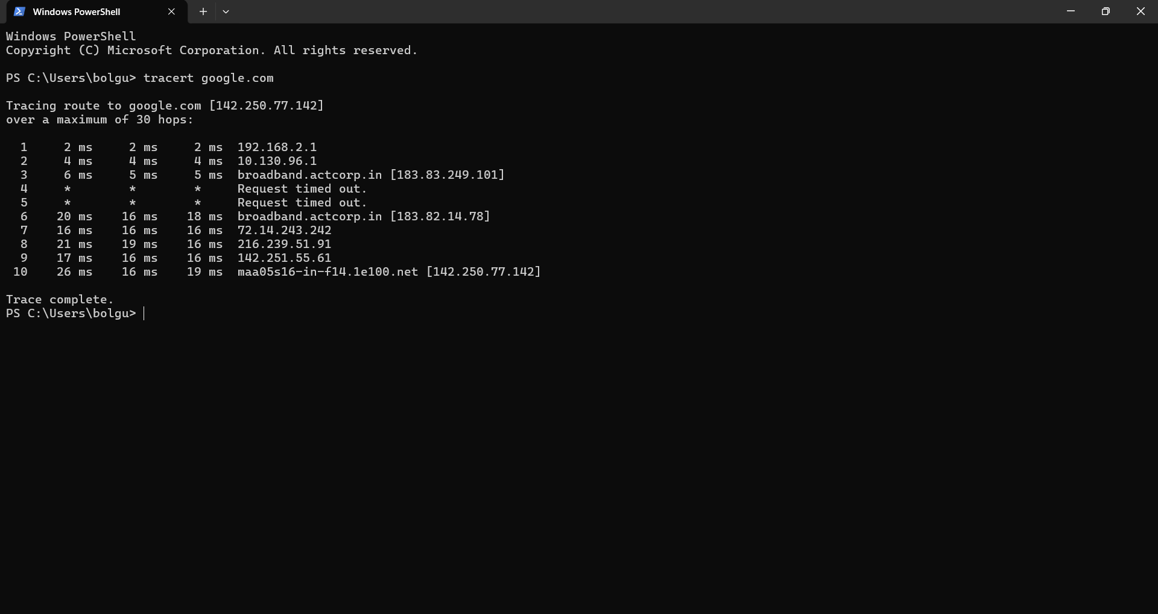
Tracret google.com

Slide 11
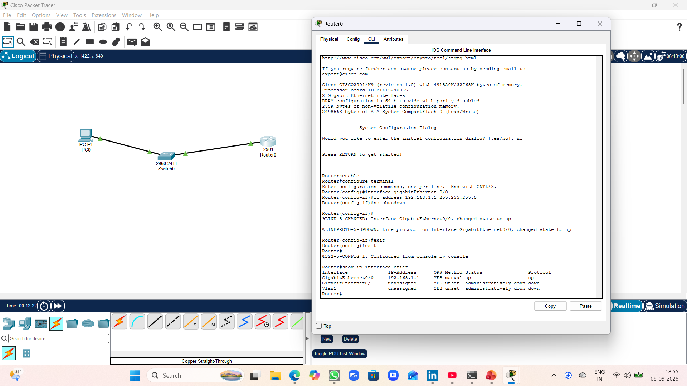
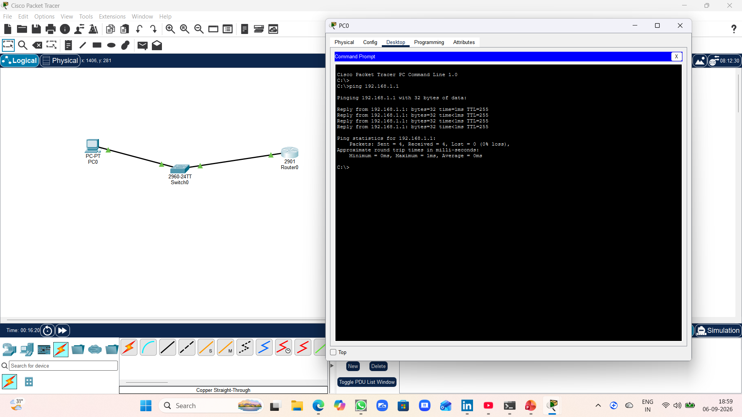
TASK 6 : NETWORK SIMULATIONS
Ping 192.168.1.1

Slide 12
THANK YOU

